Slide 1
Speakers Edition!

Slide 2
Before you start
Start with a Clear Goal: Know the purpose of your presentation and what you want your audience to take away from it.
Structure Your Content: Organize your content into a clear and logical structure. Use headlines, bullet points, and visuals to make it easy to follow.
Use Visual Aids: Use visuals such as images, videos, and graphs to help illustrate your points and make your presentation more engaging.
Keep it Simple: Avoid overloading your presentation with too much information. Keep it simple and to the point.
Practice, Practice, Practice: Practice your presentation until you feel confident and comfortable delivering it.
Engage Your Audience: Use storytelling, humor, and interactive elements to keep your audience engaged and interested in your presentation.
Rehearse with Timing: Time your presentation during rehearsals to ensure you are keeping to the allotted time and not rushing or dragging on.
Seek Feedback: Get feedback from a trusted colleague or mentor to help you improve your presentation and delivery.
Don't Delete the Sponsor Slide: Acknowledge your sponsors in your presentation, as they are the reason you are able to present.
Say Thank You: Make sure to thank your audience and sponsors for their time and attention, as well as for their support.

Slide 4
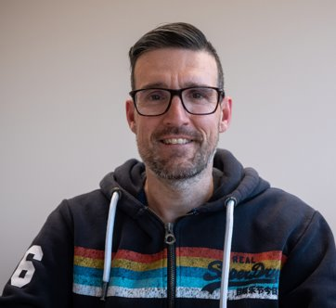
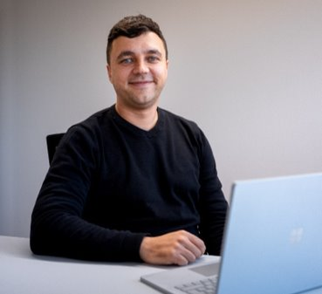
Speaker intro
Ferran Chopo
Power Platform Advisor - Forward Forever
https://www.linkedin.com/in/fchopo/
https://twitter.com/fchopo
Xavi Segura​
Senior Consultant – PlanB Gmbh​
https://www.linkedin.com/in/xavisegura/
https://twitter.com/xavi_segcri

Slide 5
Agenda (optional)
Buckle up, here's what we're going to cover today:
[Topic 1]: [Brief Description of Topic 1]
[Topic 2]: [Brief Description of Topic 2]
[Topic 3]: [Brief Description of Topic 3]
[Topic 4]: [Brief Description of Topic 4]
[Topic 5]: [Brief Description of Topic 5]
Q&A: Ask me anything!

Slide 6


Fusion Teams
Effective application development depends on efficient communication of business requirements and ideas for meeting them.
Communication
Business User
Professional Developer
The business user can quickly innovate and experiment to improve processes thanks to Power Apps and Power Automate.
In order to meet business requirements, it is often necessary to interact with existing systems for which there is no connector. This is where the professional developer comes into play.

Slide 7
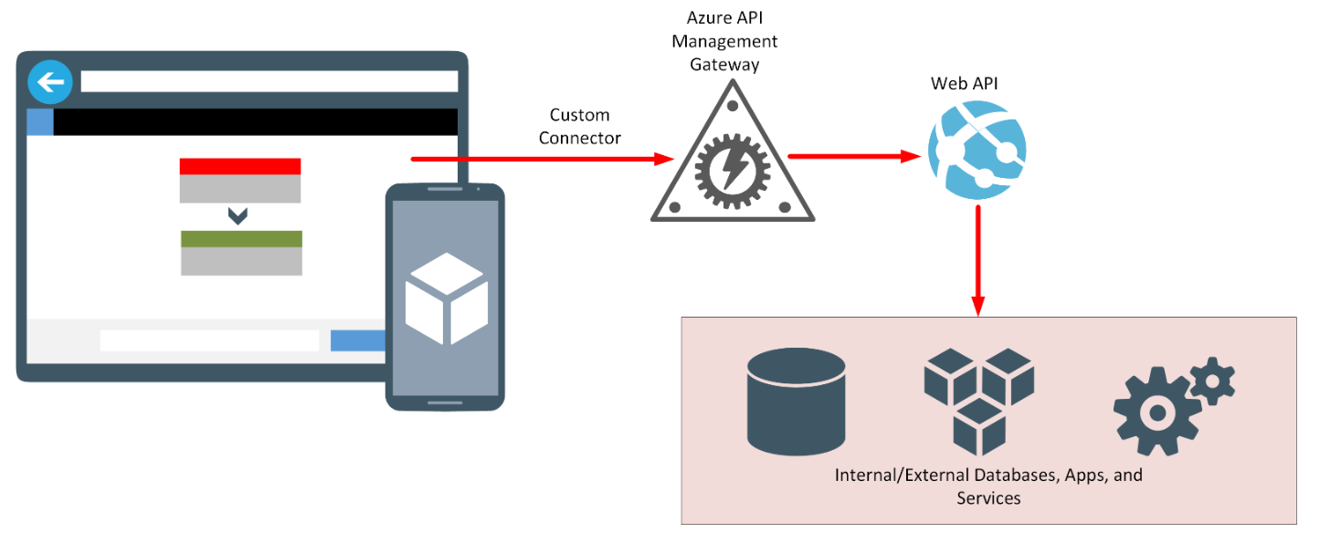
Fusion Teams
A typical use case for creating a custom connector is to allow an application access to other services and systems inside and outside the organization.

Slide 8
Content slide
Topic: [Topic]
Hook: [Interesting or surprising fact about the topic]
Key Point 1: [Your Key Point 1]
Visual: [Visual Aid (Image, Graph, Video) that supports the Key Points]
Actionable Takeaways: [List of Actionable Steps that the Audience can Take Away from the Presentation]

Slide 9
Thank you slide
Recap: Let's summarize what we covered today:
Key Point 1: [Your Key Point 1]
Call to Action: Here's what you can do next:
Actionable Step 1: [Your Actionable Step 1]
Thank You: [Express Your Gratitude for the Audience's Time and Attention]

Slide 10
Contact slide
Contact: [Provide your contact information, so the audience can reach out to you]
Social Media: [List of your social media handles]
Email: [Your email address]
Website: [Your website URL]

